Slide 1

Kotlin Rocks
Why Kotlin!?
Change your world!
Notes:
To use this title animation slide with a new image simply 1) move the top semi-transparent shape to the side, 2) delete placeholder image, 3) click on the picture icon to add a new picture, 4) Move semi-transparent shape back to original position, 5) Update text on slide.

Slide 2
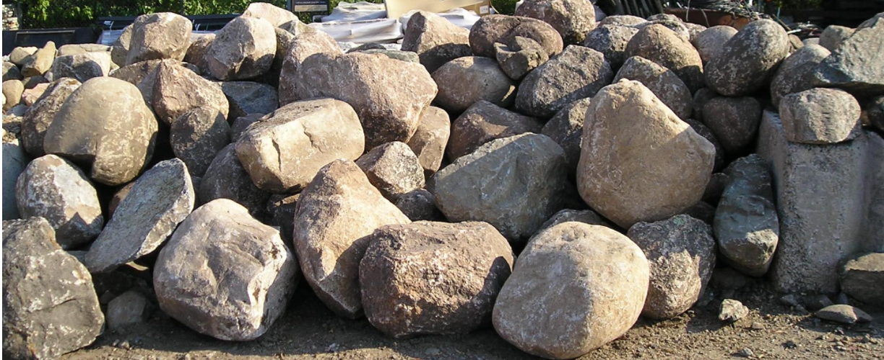
Brian Keating | https://briankeating.net
About Me
Scope
Why
Audience
IntelliJ
Experience
Patterns

Slide 3
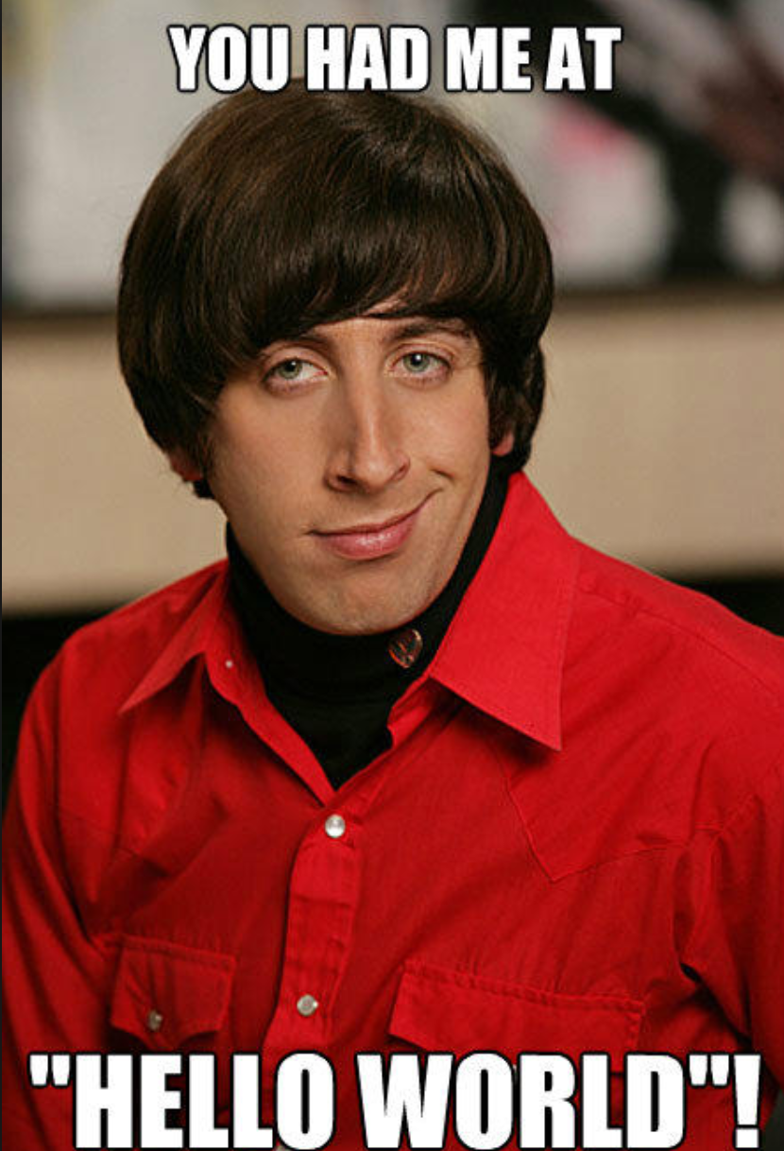

Slide 4
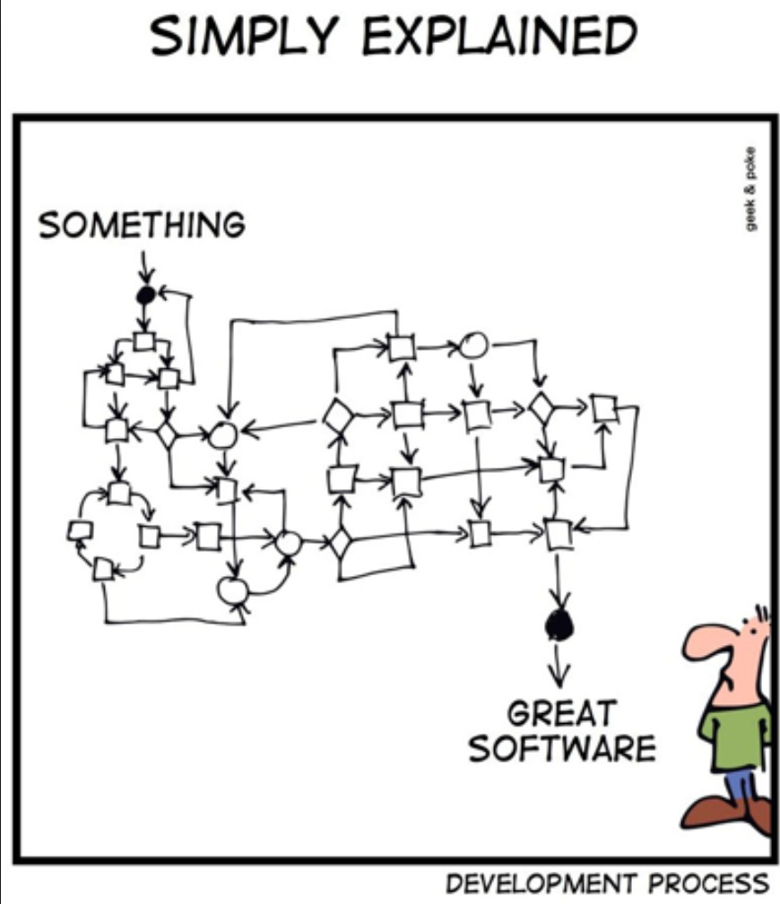
Patterns
Singleton
Factory
Listener
Façade
State
Strategy
Visitor
Delegation
Command
Adapter

Slide 5

Kotlin
The Race is on..

Slide 6
USE TRANSITIONS & SECTION DIVIDERS
TIP
To keep the audience focused, always use the same transition before a new topic
!
Consistency helps viewer see connections in the story – use same layout and design for individual sections and give your audience a mental check-point.

Slide 7
THE STAGE HAS BEEN SET go ahead and follow the basic 5 steps
1
2
3
4
5
Understand your brand and audience; speak in an authentic voice
Get your facts straight with 5 W’s
The power of specifics, details, and imagery
Show, don’t tell
Know the end at the beginning
Reference : The basics you can find anywhere 5 Steps To Successful Storytelling Published on April 5, 2014 Featured in: Marketing & Advertising

Slide 8

QUESTIONS?

Slide 9
Kotlin Rocked!
THANK YOU

